Slide 1
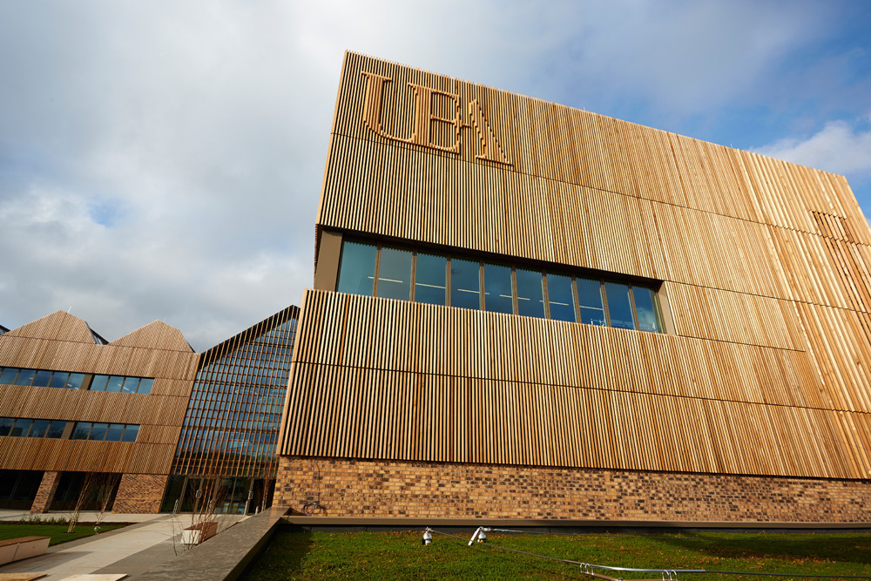





Microbes and cancer: from sequence to consequence?
Daniel Brewer – MMB masterclass – September 2023
Notes:
Introduce myself

Slide 2
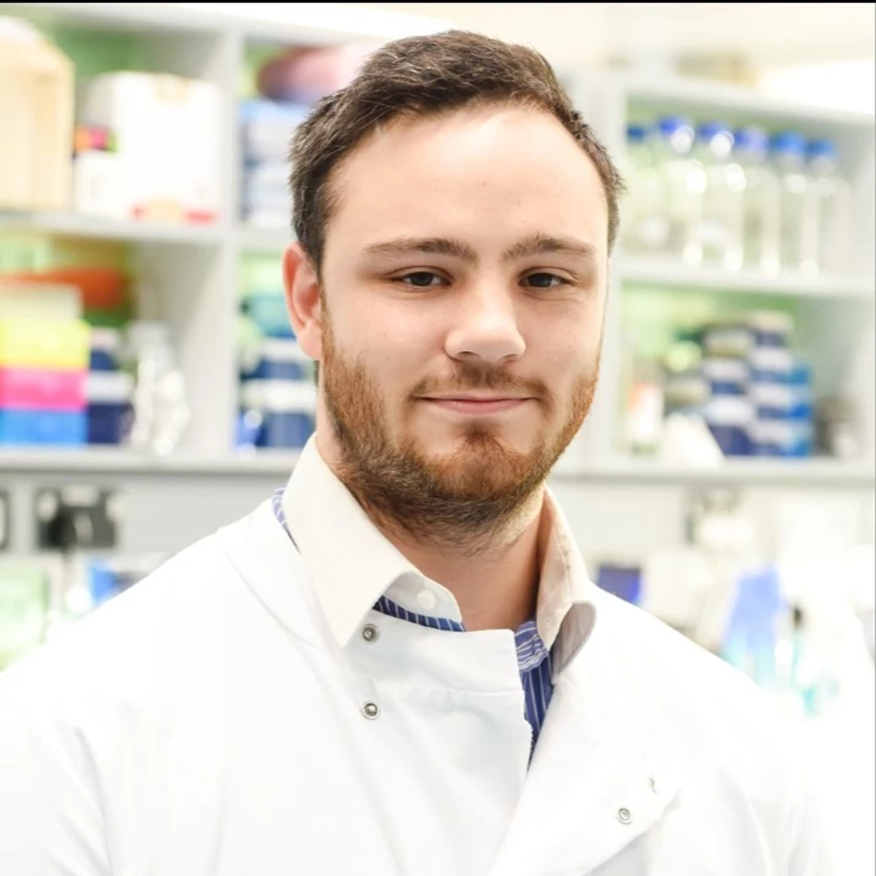

Abraham Gihawi
Notes:
Get Abe to say a bit about his journey.

Slide 3
Outline
Introduction to microbes and cancer
Overview of our research
Break
Tutorial 1 – Investigating pitfalls of human cancer microbiome studies
Break
Tutorial 2 – From microbiome community matrices to clinical biomarkers

Slide 4
Introduction to microbes and cancer

Slide 5
Rous Sarcoma Virus
Francis Peyton Rous - 1911
First evidence of infection & cancer
1966 Noble prize
Finally accepted fully through work of Howard Temin and David Baltimore (1970; Noble prize in 1975)
Fig: Weinberg RA. The Biology of Cancer. 2014
Notes:
The first infectious source of cancer was discovered in 1911, when a virus was first associated with cancer in chickens.
Frances Peyton Rous, a virologist at Rockefeller Institute for Medical Research, transferred bacteria-free and cell-free extracts from a chicken with a lump in its breast to a healthy chicken.
Much to his surprise, the recipient chicken grew a cancer.
This led to the designation of RSV (Rous sarcoma virus) as the first known tumour virus and to the recognition of a new paradigm in cancer research—the virus-induced cancer.
But at the time it was dismissed by most scientists at the time and Rous terminated research on RSV only a few years later
Rous later (55 years) received the 1966 Nobel Prize for his discovery of tumour-inducing viruses.
Temin and Baltimore proved the mechanism by which this virus could cause cancer by reserve transcribing RNA and insertion into the hosts DNA.

Slide 6
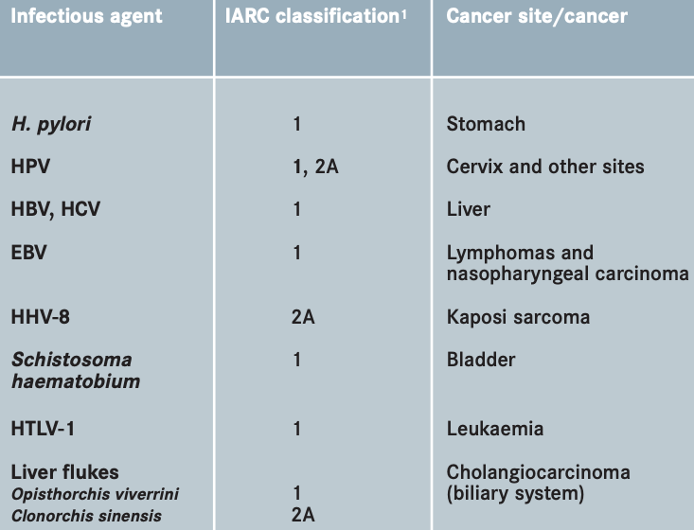
Pathogens in cancer
Estimated 20-40% of cancers have a pathogen association
Others:
HIV
Merkel Cell Polyomavirus
Numerous bacterial associations
H. pylori and bowel cancer
Discovery of new associations has the potential to impact prevention, better stratification, and treatment
Notes:
These are ones with IARC (International agency for research in cancer - is the specialised cancer agency of the World Health Organization) classifications
Strongest evidence shown in table
Group 1 – Carcinogenic to humans
Group 2A – Probably carcinogenic to humans
More than 4 in 10 stomach cancer cases in the UK caused by H. pylori

Slide 7
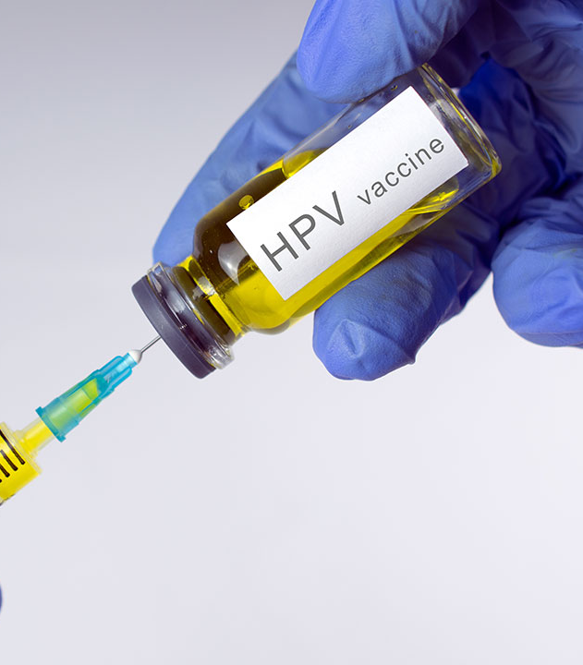
HPV Vaccine
UK implemented a human papillomavirus (HPV) vaccine programme for teenage girls in 2008
Cervical cancer rates reduced by almost 90%
Un-realised potential worldwide due to expense
In Sub-Saharan Africa cervical cancer is the leading cause of cancer death in women.
Notes:
HPV vaccine
-> Given in UK since 2008
-> reduced pre-cancerous cervical disease in women by 71%
-> Likely to prevent most cases of cervical cancer
https://www.csis.org/analysis/unrealized-promise-hpv-vaccination

Slide 8
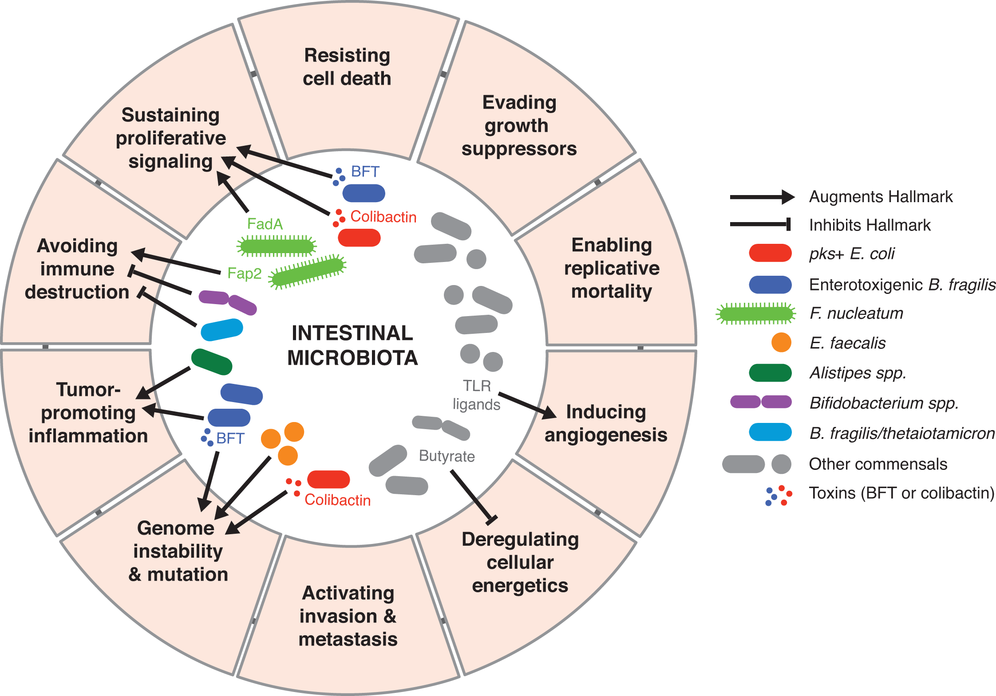
How do Pathogens Cause Cancer?
HPV - Specific mechanisms
Implants DNA inside ours
Stops faulty cells killing themselves
E6 oncoprotein inhibits P53
Encourages proliferation
E7 oncoprotein binds to Rb preventing tumour suppression and driving proliferation by activating transcription factors
Infected cells continuously replicate (HPV 16 and 18 can immortalize cell lines in vitro)
H. Pylori - More generalized
Inflammation & stress → DNA damage
Bacterial toxins → excessive cell growth
Avoidance of immune response
Fulbright LE, Ellermann M, Arthur JC. The microbiome and the hallmarks of cancer. PLoS pathogens. 2017 Sep 21;13(9):e1006480.
Notes:
HPV 16 and 18 can immortalize cell lines in vitro.
E6 oncoprotein inhibits P53
E7 oncoprotein binds to Rb preventing tumour suppression and driving proliferation by activating transcription factors
In the latest Hallmarks of cancer “Polymorphic microbiome” has been recognized as an enabling characteristric

Slide 9
Overview of our research

Slide 10
Whole Genome Sequencing
What we like to think happens:
Tumour + Sequencer = Tumour DNA sequences
What actually happens:
Tumour + Surrounding Cells + Laboratory Contamination + Sequencer = Mostly Human DNA Mix
Notes:
Identify microbes present
Cancer is a disease of the genome
In tumour samples, we can find associations between cancer biological characteristics and microbes present

Slide 11

A collaboration involving more than 1,300 scientists and clinicians from 37 countries.
Analysed more than 2,600 genomes of 38 different tumour type (ICGC data) using common analysis pipelines.
Notes:
PCAWG arose from the desire to examine the data produced by ICGC in a consistent and in-depth way.
The Pan-Cancer Project extended and advanced methods for analyzing cancer genomes which included cloud computing
Previous studies focused on the 1 per cent of the genome that codes for proteins, analogous to mapping the coasts of the continents. The Pan-Cancer Project explored in considerably greater detail the remaining 99 per cent of the genome, including key regions that control switching genes on and off -- analogous to mapping the interiors of continents versus just their coastlines.
Development of novel post-variant approaches
Driver for development in the field

Slide 12
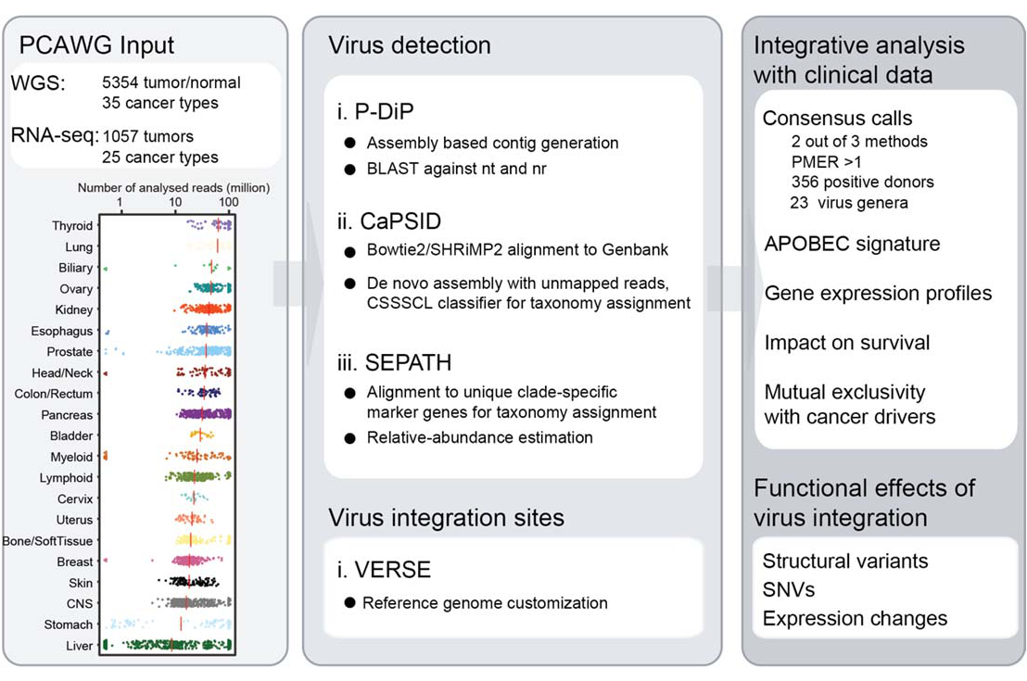
PCAWG16 - Pathogens
Zapatka, M. et al. The landscape of viral associations in human cancers, Nat. Genetics, 2020

Slide 13
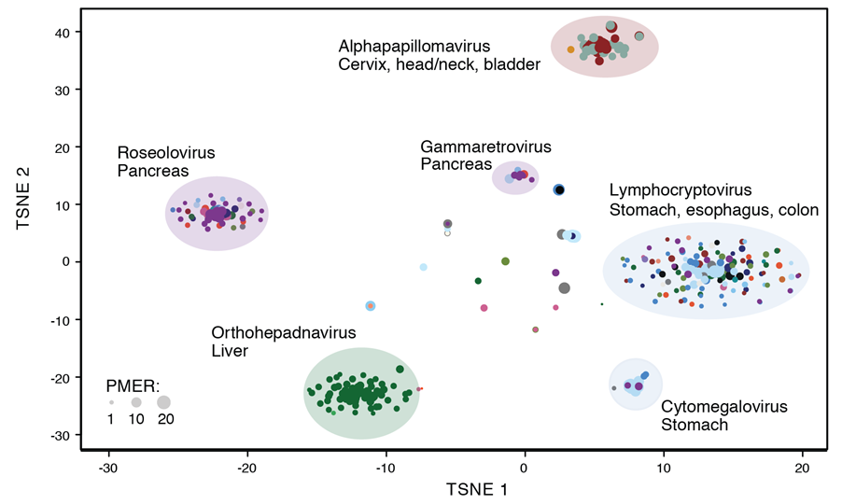
PCAWG16 - Results
Viruses were detected in 382 genomic and 68 transcriptome data sets.
High prevalence of known tumour associated viruses such as EBV, HBV and several HPV types.
Marc Zapatka, Ivan Borozan, Murat Iskar

Slide 14
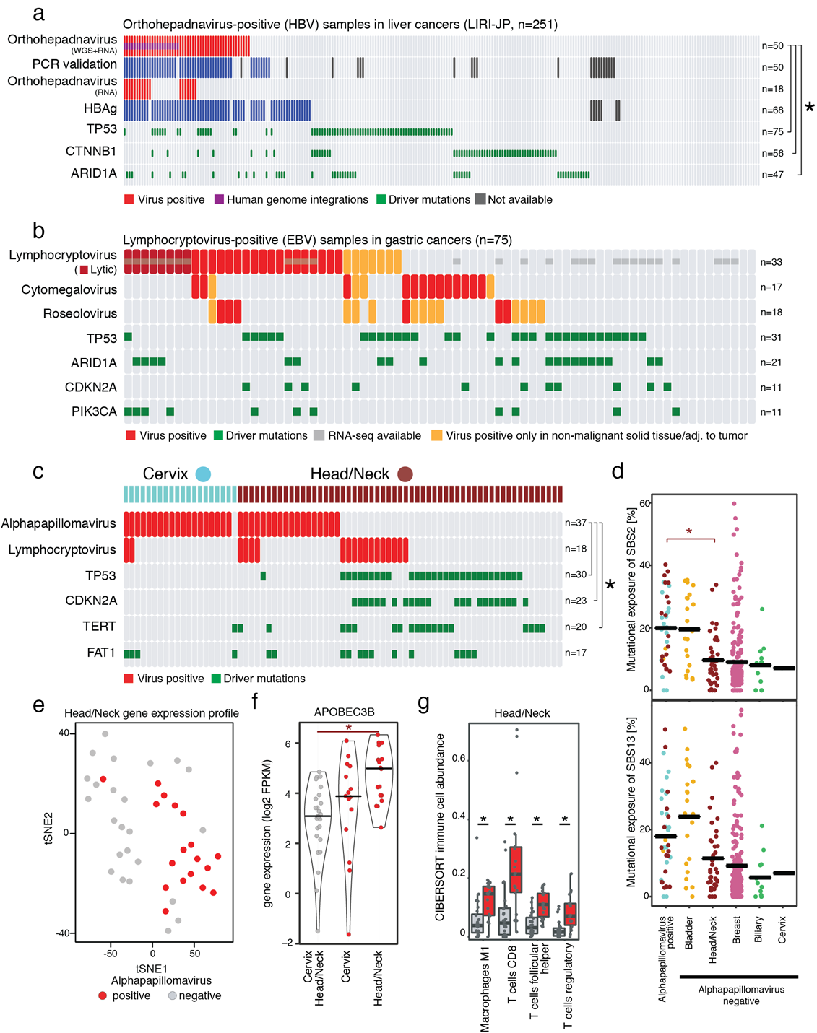
PCAWG16 - HPV presence was significantly exclusive with well-known driver mutations in head/neck cancer
HPV-positive tumours exhibit an almost complete mutual exclusivity with mutations in known drivers:
TP53 (FDR corrected P =1.73x10⁻⁵)
CDKN2A (P = 1.73x10⁻⁵⁾
TERT (P = 0.012)
This could be explained by a mutation independent inactivation of TP53 through the human papillomaviruses
Marc Zapatka, Ivan Borozan, Murat Iskar

Slide 15
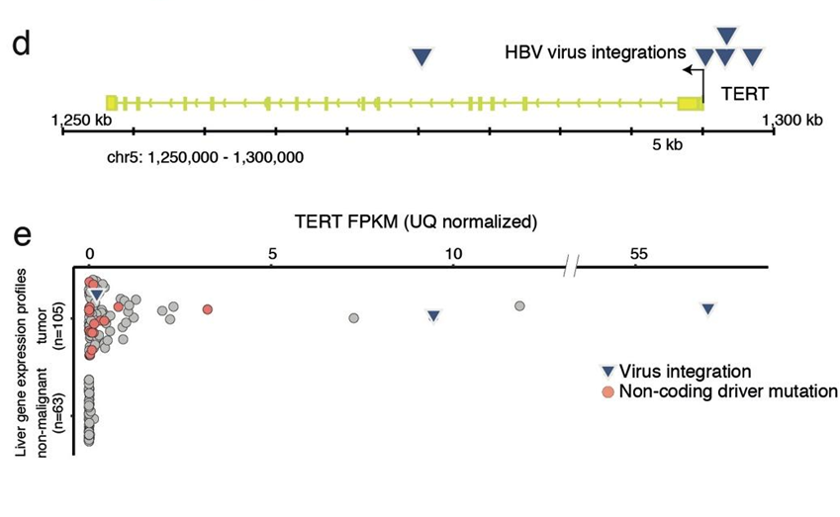
PCAWG16 - The recurrent viral integrations at the TERT promoter were coupled to high telomerase expression uncovering a further mechanism to activate this tumour driving process.
Comparing gene expression in samples with virus integration to those without, only TERT was over-expressed (fold change ≥ 2.0) in two liver cancer samples
Marc Zapatka, Ivan Borozan, Murat Iskar
Notes:
Maria from David’s group is looking at the connection between viruses and the mutational landscape in more depth.

Slide 16
PCAWG16 - HPV infection and the APOBEC mutational signatures in head & neck
SBS2 (associated with activity of the AID/APOBEC family) enriched for alphapapillomavirus positive cases in head and neck cancers (FDR corrected P = 0.02; Wilcoxon rank sum test).
The expression of APOBEC3B is significantly higher in the virus positive head and neck cancers compared to their virus negative counterparts (P < 0.001, Wilcoxon rank sum test)
Suggesting the role of impaired mechanism of antiviral cellular defence as a driving force in the development of head/neck carcinoma.
Marc Zapatka, Ivan Borozan, Murat Iskar

Slide 17
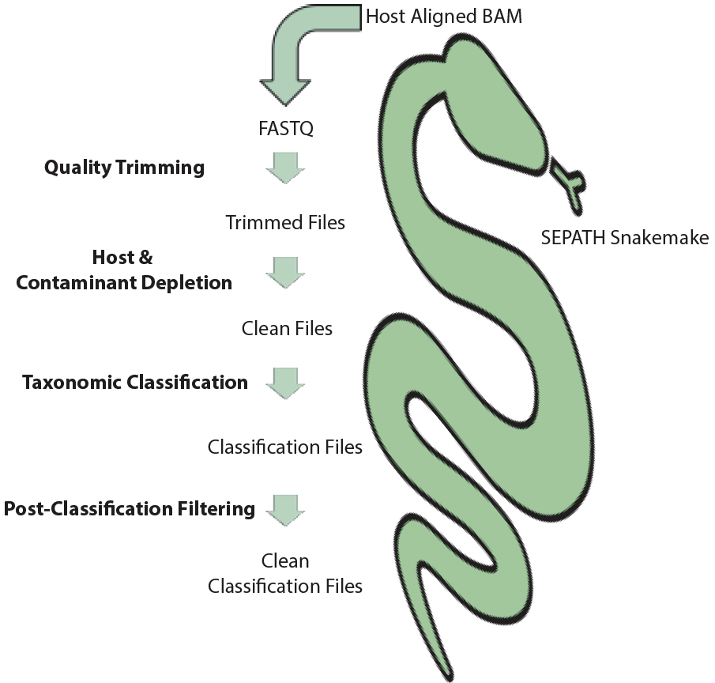
Developing SEPATH further through benchmarking studies
100x paired end metagenomes:
~300M human reads
1-40m bacterial reads
Varied number of species (1-77)
Based on metrics from PCAWG
10x Viral simulations
Benchmarks:
Human depletion (BBDuK efficiently removes human & keeps bacterial reads)
Classification on raw reads & assembled contigs
Bacteria quantification
Consensus approach
Gihawi, A. et al. SEPATH: benchmarking the search for pathogens in human tissue whole genome sequence data leads to template pipelines. Genome Biol 20, 208 (2019) doi:10.1186/s13059-019-1819-8

Slide 18
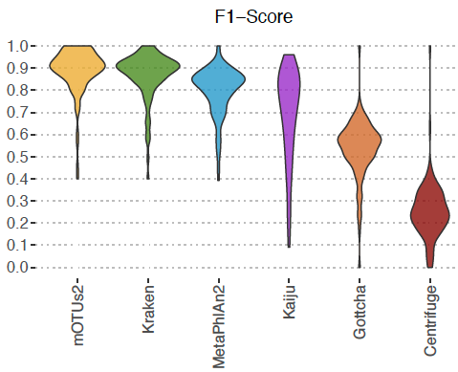
SEPATH benchmark - Bacterial Classification
mOTUs2 and Kraken prevail
Abraham Gihawi
Notes:
Binners: What is it and how specifically can we identify it?
Each tool has a weird and wonderful way of classifying --- ie Kaiju translates in 6 reading frames before classifying
mOTUs2 and Kraken performed well at GENUS
F1 is the harmonic mean of precision (PPV) and recall (Sensitivity)

Slide 19
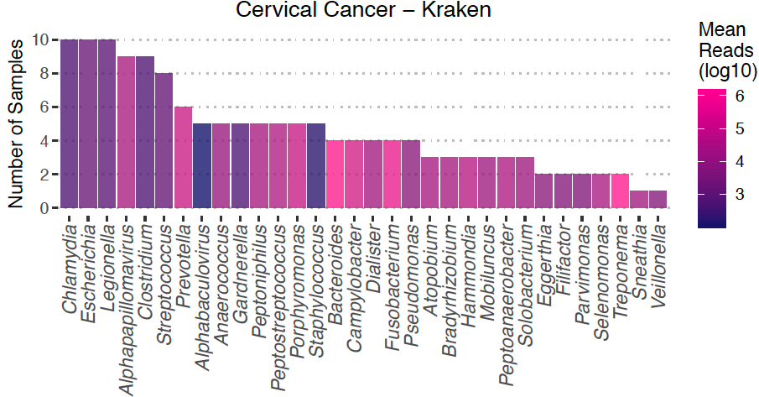
SEPATH Benchmark – Testing on real data (PCAWG)
SEPATH identified pathogens in line with current research:
Alphapapillomavirus was found in 9/10 cervical squamous cell carcinoma samples, with a high average number of sequencing reads compared to other taxa.
Helicobacter pylori identified in 50% of stomach cancer samples.
Medulloblastoma samples are expected to be mostly sterile and nothing much was detected.
Abraham Gihawi

Slide 20
Genomics England and Contamination
Genomics England
UK government project
Sequenced 100,000 whole genomes including ~40,000 genomes from cancer patients
Results
Structure
HPV Identification and Overlap with TP53 Mutational Status
HTLV-1 Diagnosis
ABBS and Sarcoma Survival
Contamination
A confounder of all metagenomic analysis of WGS is contamination, but particularly in low biomass studies.
Oral
Colorectal
Notes:
Sources:
Kitome
Preparation in unclean environment
Between sample splash.

Slide 21
Prostate Cancer and Bacteria - Background
Inflammation
Strong support for a link between chronic inflammation and prostate cancer development
Induction of inflammation by bacteria is believed to be critical in development of other cancer types.
Prostatitis
Bacterial infection can cause prostatitis
P. Acnes
Recurrent isolation of Propionibacterium acnes from prostate tissue
In animal models P. acnes infection was capable of inducing chronic inflammation
Mycoplasma
A striking association between mycoplasma infection (based on a serological assay) and prostate cancer development

Slide 22
Prostate Cancer and Bacteria under the microscope
Fluorescence microscopy images of urine samples stained with DAPI demonstrated a striking association between the presence of microorganisms in urine and D’Amico category in prostate cancer patients
Rachel Hurst

Slide 23
Certain Bacteria is Associated with Aggressive PrCa
Recurrent multiple anaerobic bacterial genera (ABBS genera: Fenollaria/Ezakiella, Peptoniphilus, Porphyromonas, Fusobacterium and Anaerococcus)
Patients with at least one of these were associated with a poor outcome in three independent datasets:
16S on urine samples (n=24)
RNAseq on urine samples (n=24)
Whole Genome Sequencing on ICGC UK prostatectomy samples (n=204)
Shyam Rallapalli, Abraham Gihawi

Slide 24
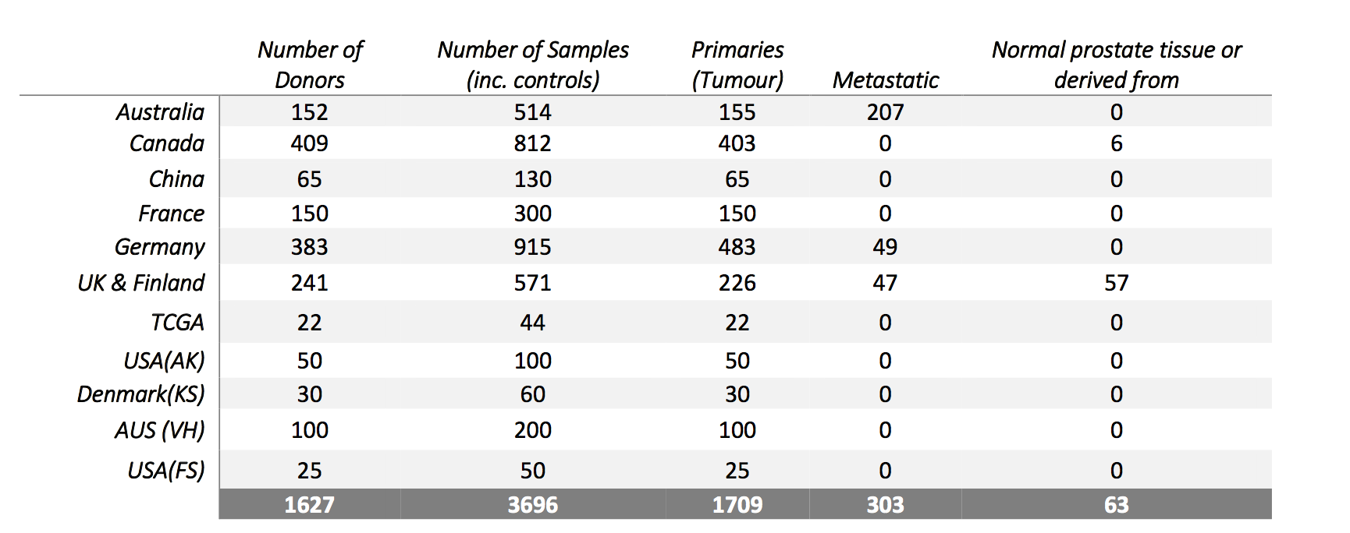

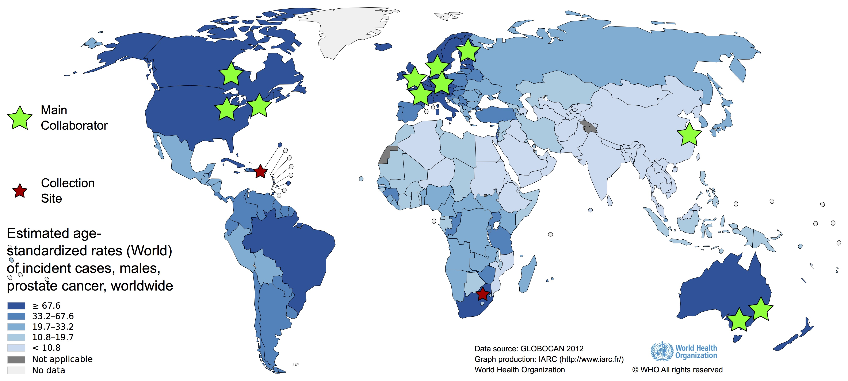

PanProstate Cancer Group
2012 Cancers (1709 primary, 302 metastatic)

Slide 25
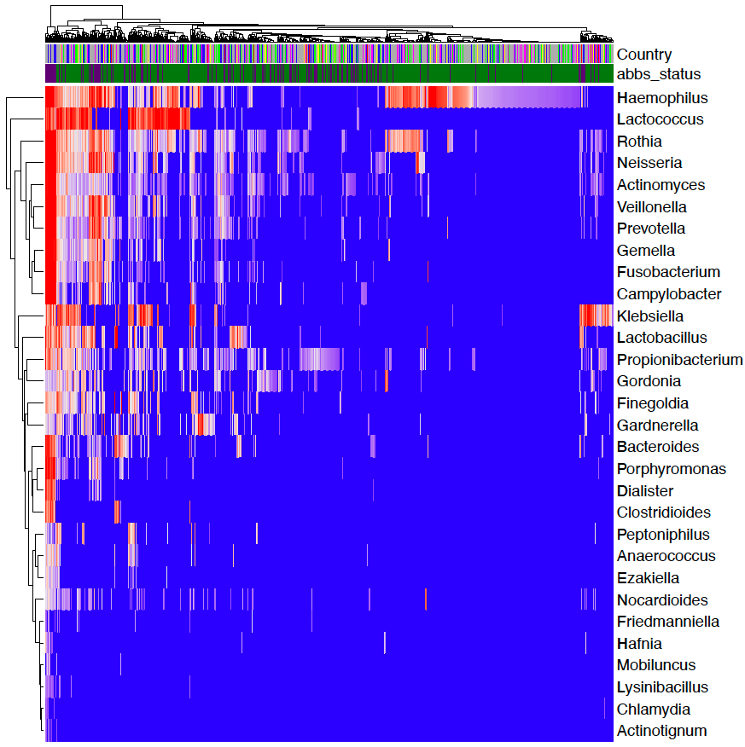
PPCG Microbiome Result Summary
Microbial classifications N=2,176 WGS
1,363 Genera
4,208 Species

Slide 26
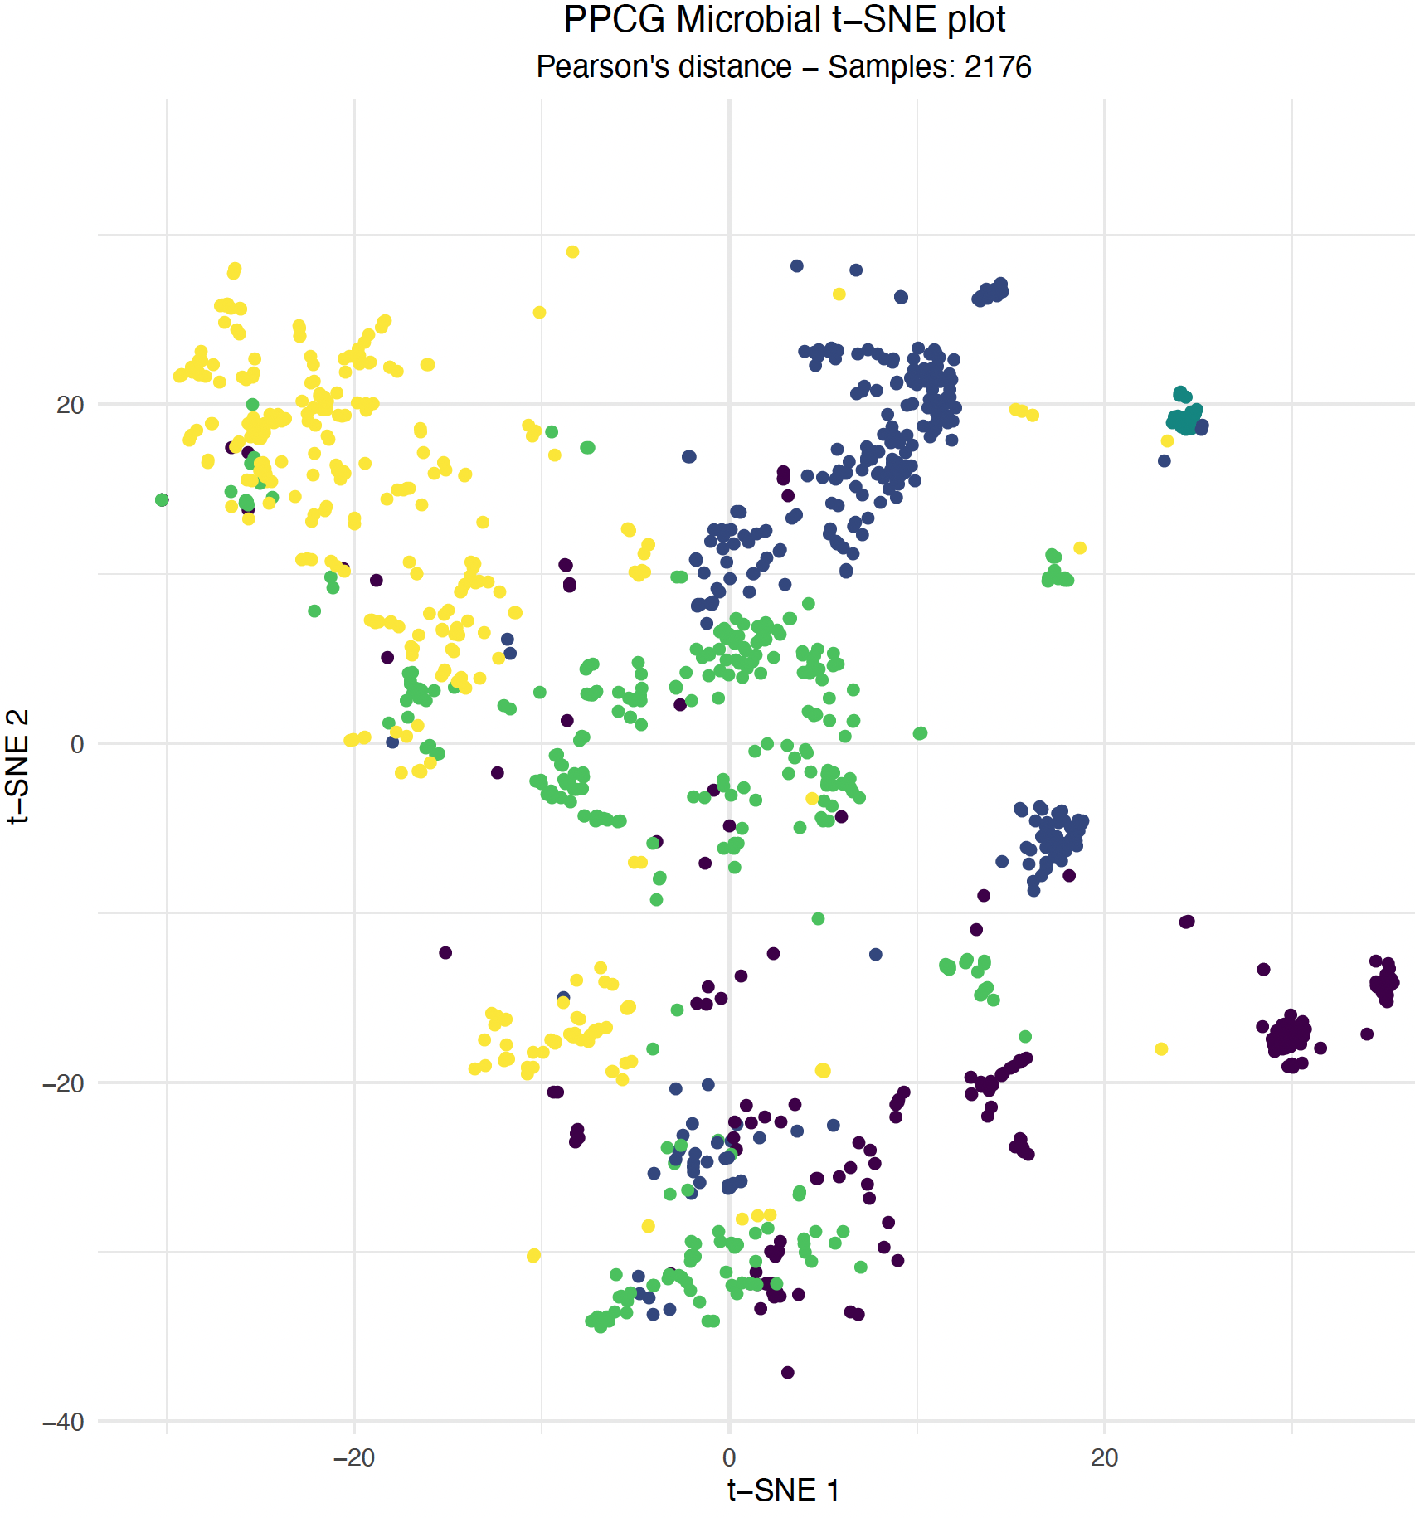
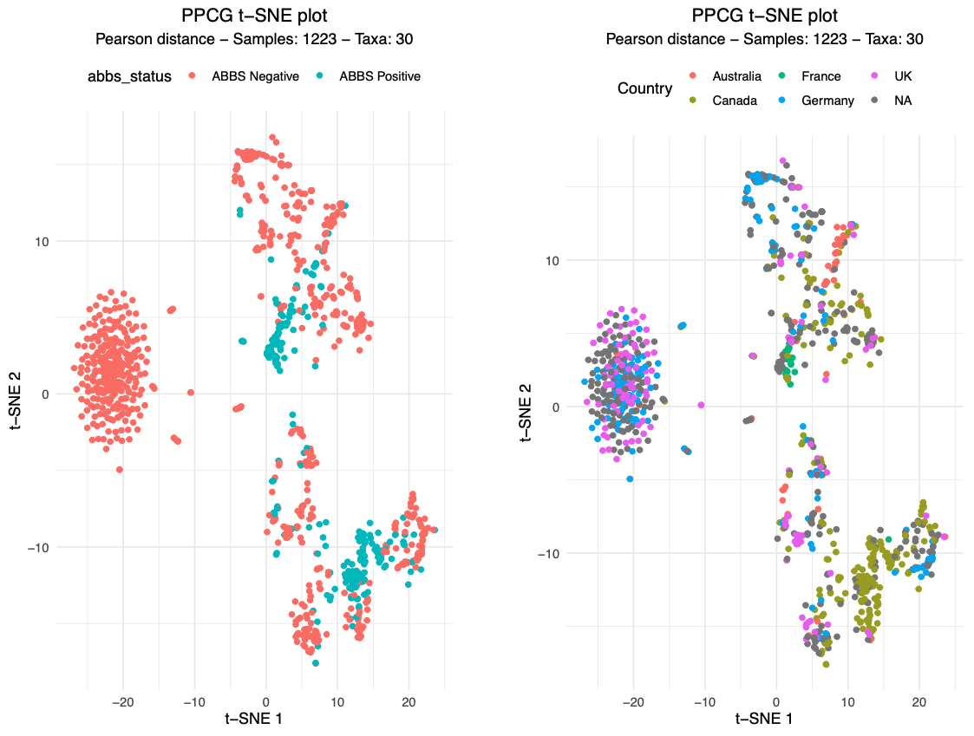
PPCG – Overall Structure
Notes:
Huge batch effect
Appears diminished when looking at 30 prostate cancer associated bacteria
Appears to be grouping by ABBS positive samples

Slide 27
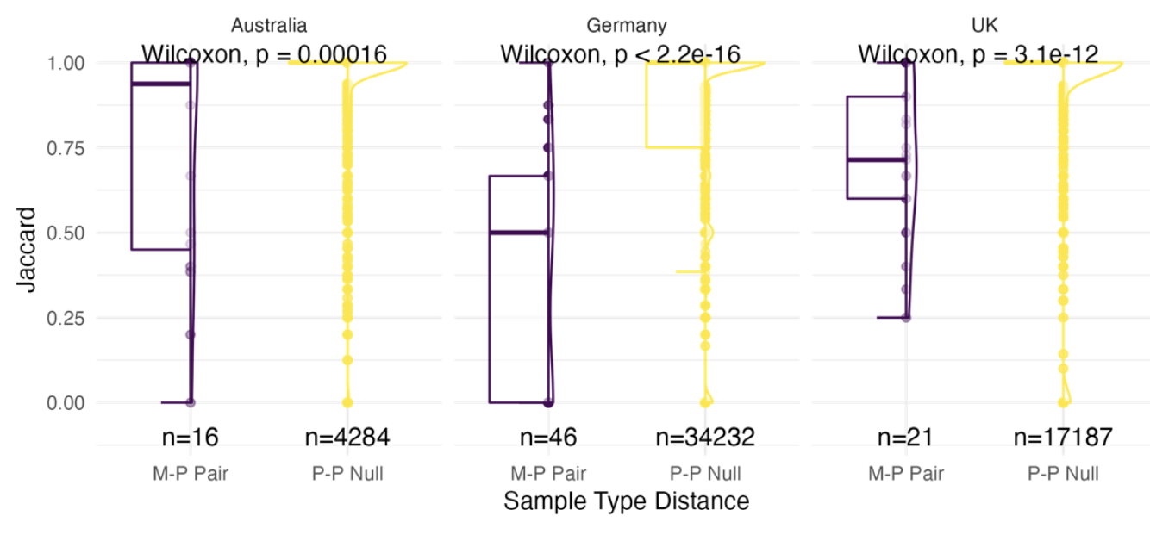
Microbiome is closer in paired primary and metastatic samples

Slide 28
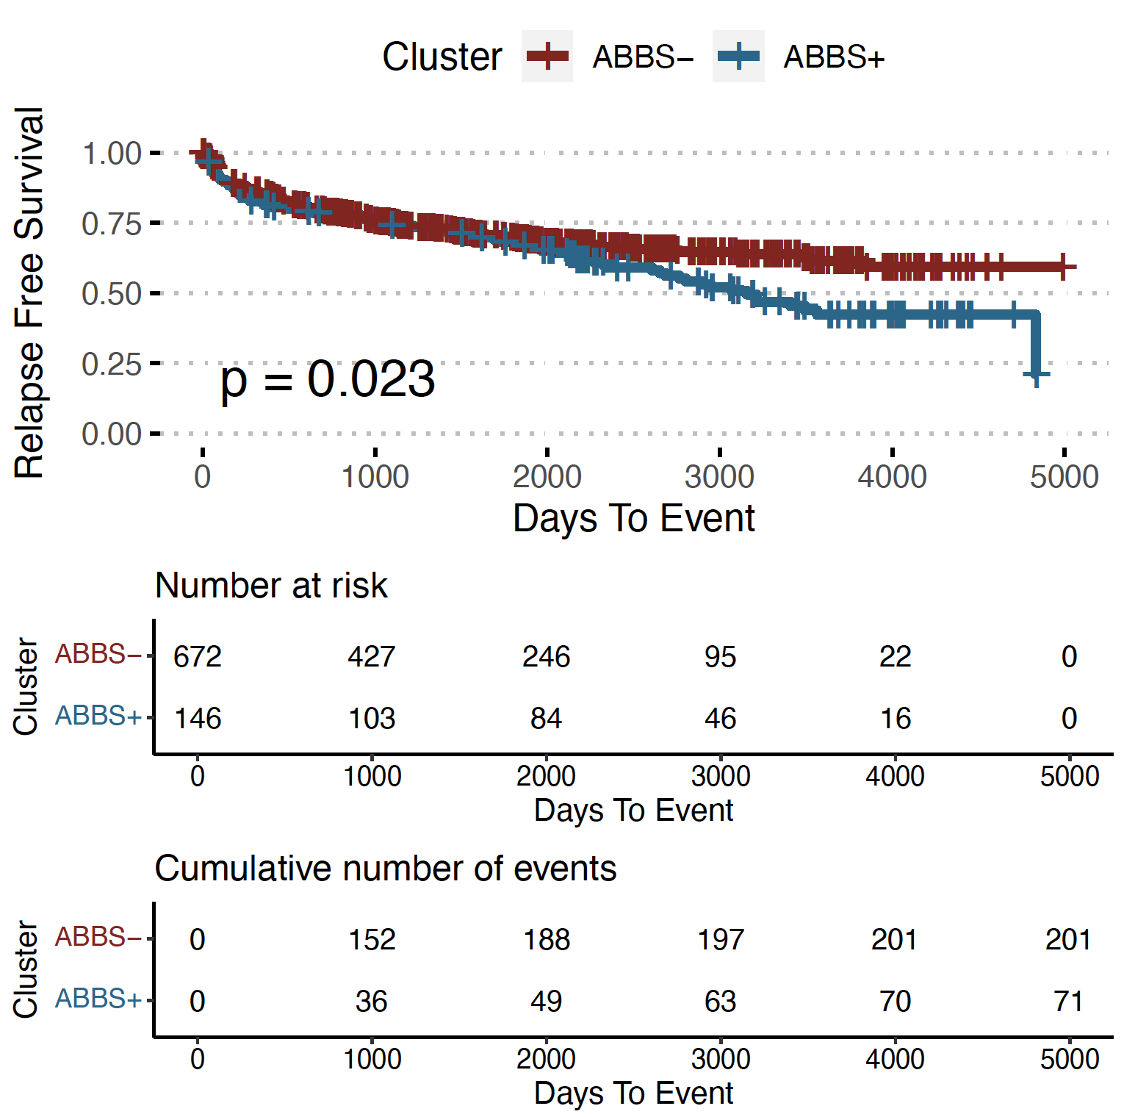
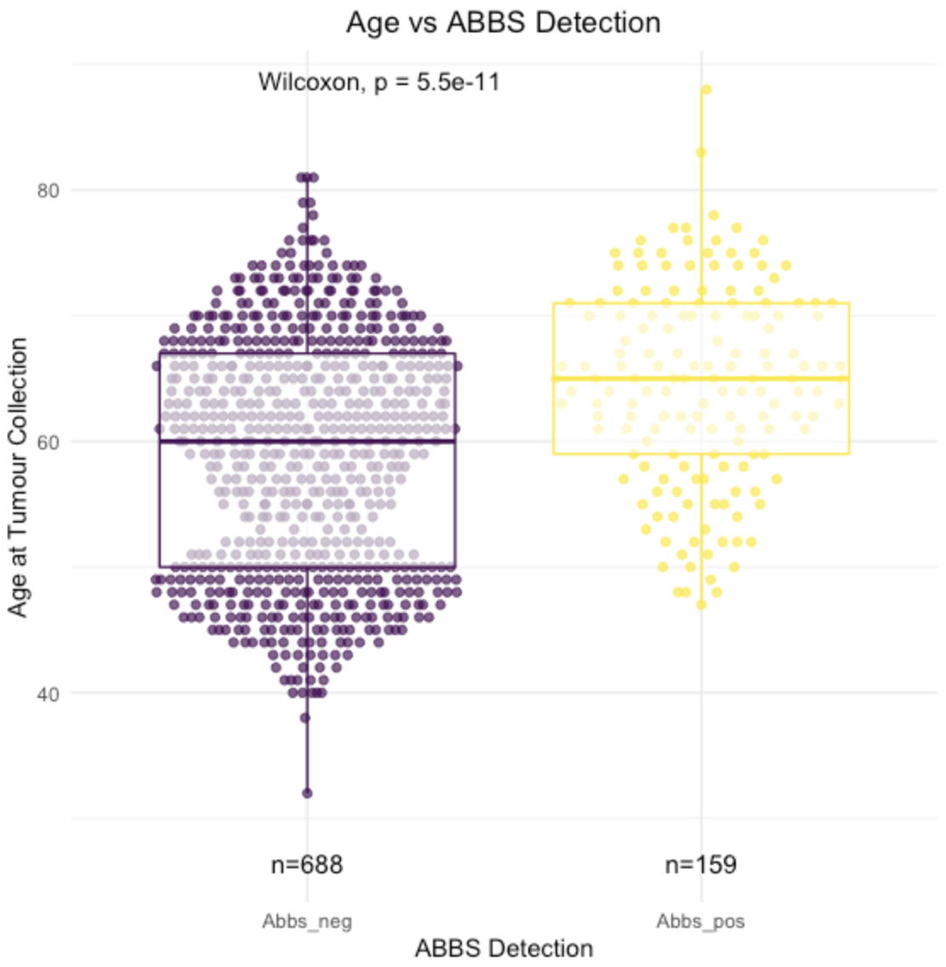
Validating Previous Findings
- Age (+ clock like SBS-1 association)

Slide 29
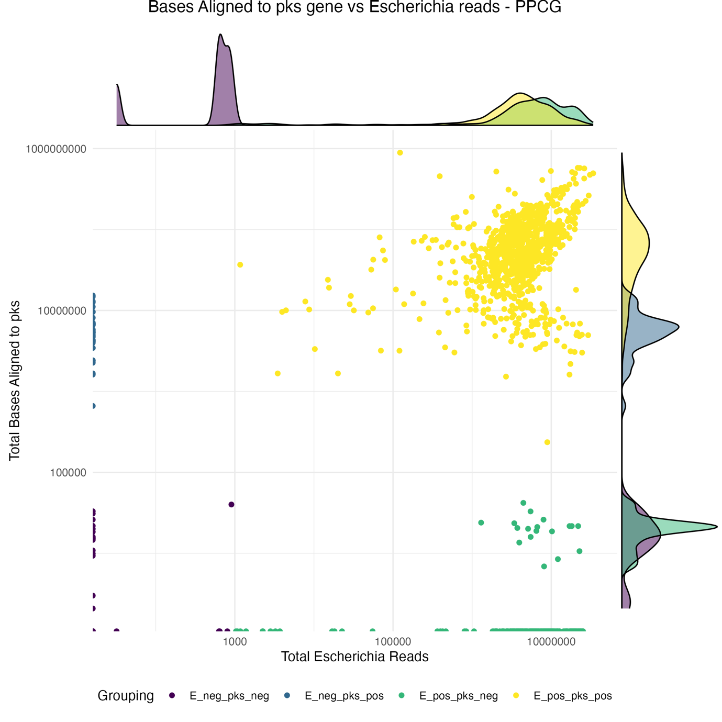
PPCG - Genotoxic Genes
Pks = Polyketide synthase genomic island → colibactin (colorectal DNA crosslinks and progression)
Pipeline developed to search for pks
Applied to entire dataset
Searching for associations with mutational signatures (SBS88)
Notes:
Pks – Polyketide synthase pathogenicity island
Produces Colibactin
Causes DNA damage
Associated with aggressive colorectal cancer
Produces particular mutational signature (SBS88)
Four distinct clusters
52% samples Escherichia+ 45% pks+
Some pks+ without Escherichia (likely other enterobacteria carrying pks)
Probably a lot of samples that just so happen to be positive for pks and Escherichia but the pks is actually in another enterobacteria
100% SBS88 participants pks+ / Escherichia+

Slide 30
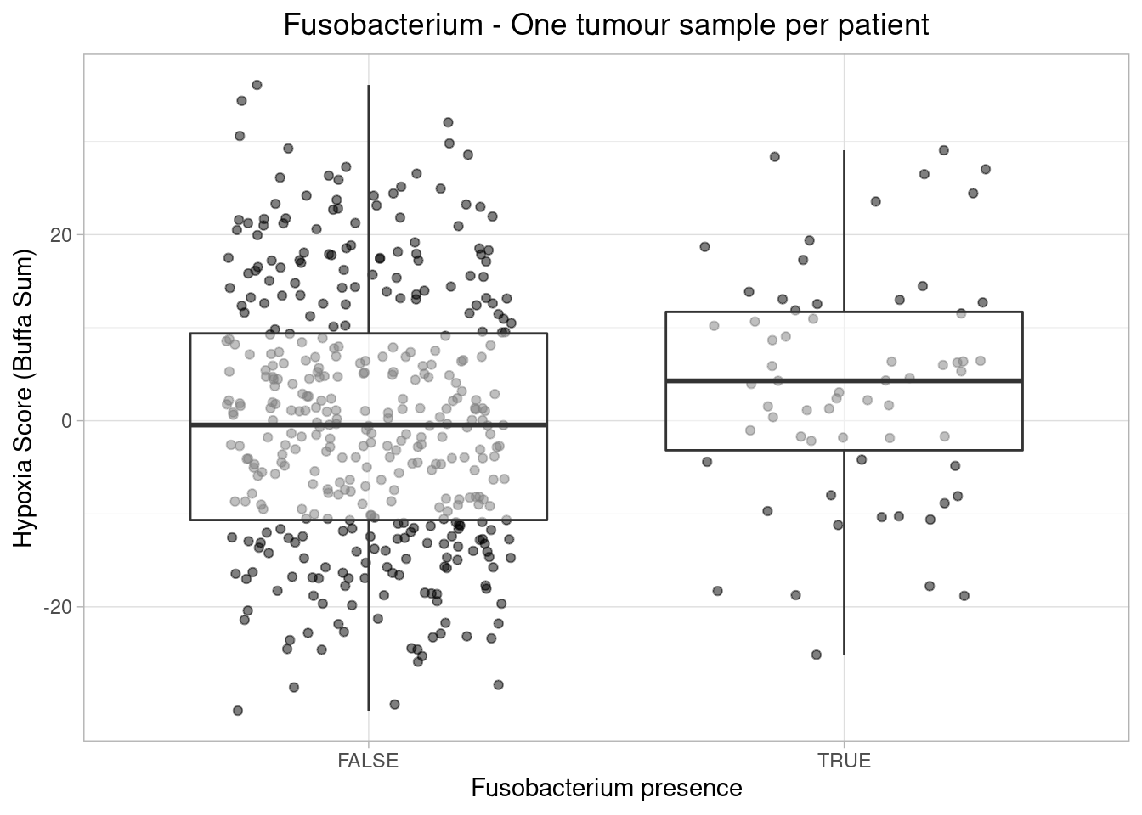
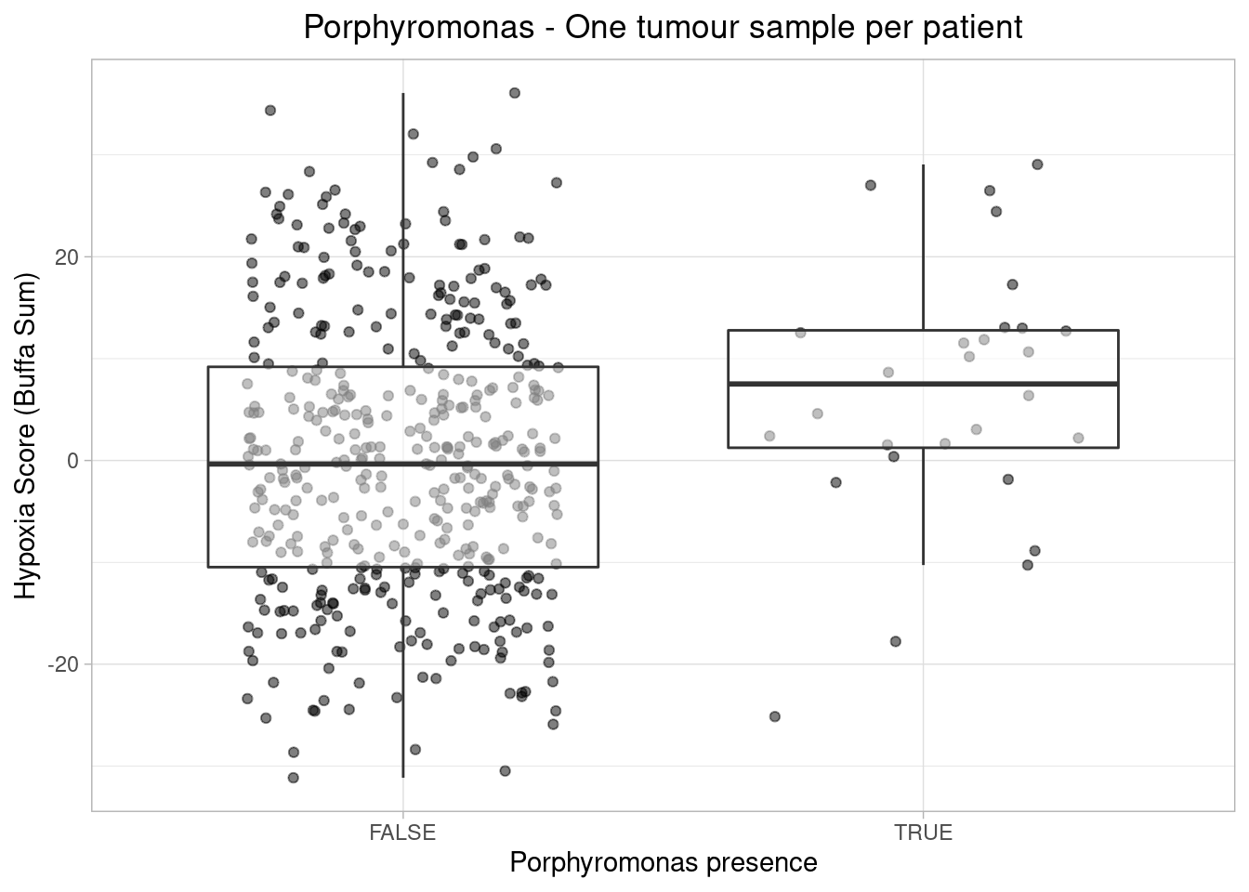
PPCG - Hypoxia
Hypoxia: Maria Jakobsdottir - David Wedge
p = 0.00952
p = 0.02618
Maria Jakobsdottir & David Wedge
Notes:
One of the benefits of the PPCG is collaboration
Species level evidence for P. gingivalis and P. asaccharolytica

Slide 31
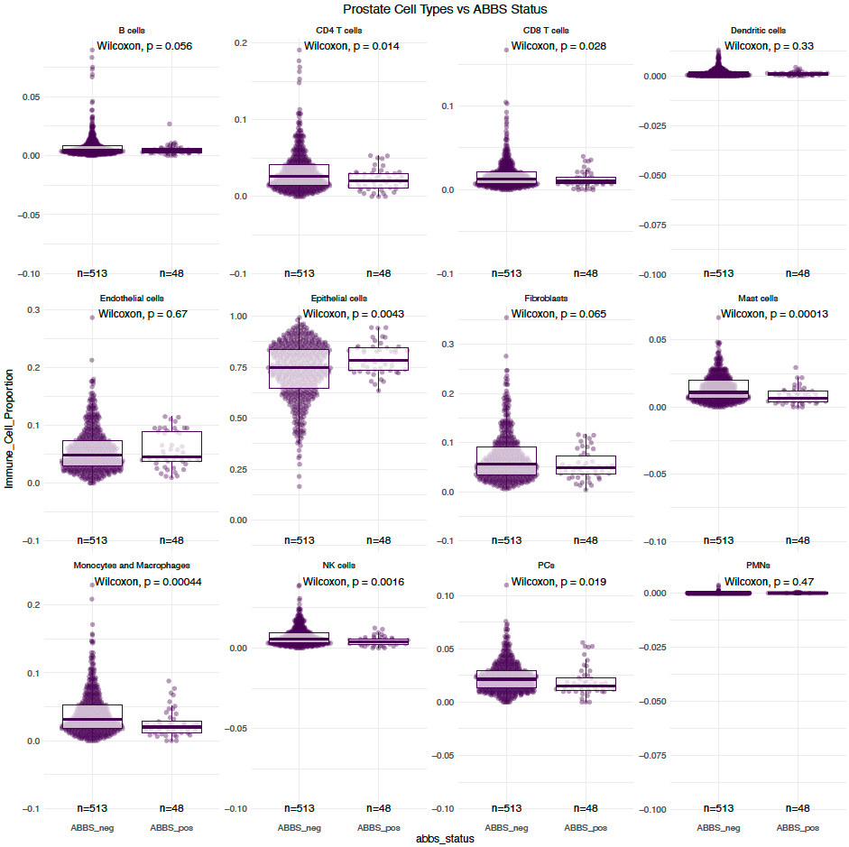
PPCG – Immune Differences
Immune Cell Deconvolution – With Investigated alongside TCGA microbial data
In ABBS+:
Higher epithelial signature
Lower other cells signature
To investigate on PPCG data
Bogdan Luca

Slide 32
Conclusion
There is the potential that bacteria plays an important role in prostate cancer
We can use whole genome sequencing of tumour samples to get a good idea of the bacteria present
The PanProstate Cancer Group has proven a fertile ground for exploring the interactions between cancer development and bacteria.
Notes:
Discovering new bacteria is labour intensive, dependent on successful isolation and culture.
We have shown that bacterial genomes can be assembles from cancer WGS

Slide 33

Abraham Gihawli
Rachel Hurst
Shyam Rallapalli
Colin Cooper
Jeremy Clark
Richard Leggett
John Wain
Justin O’Grady
Emma Meader
Gemma Kay
Martyn Webb
Katie Manley
Helen Curley
Helen Walker
Ravi Kumar
Katarzyna Schmidt
Rosalind A. Eeles Andy G. Lynch Charlie E. Massie
Lisa Crossman
Marcelino Hanna
Mark Rochester
Robert D. Mills
Richard F. Mithen
Maria H. Traka
Richard Y. Ball
Anastasios Bampalis
Anna Russell
Seshadhri Subramanian
PanProstate Cancer Group
David Wedge
Maria Jakobsdottir
PCAWG Pathogens
Marc Zapatka
Ivan Borozan
Murat Iskar

